Slide 1
Auto Financing

Slide 2
Meet the Hosts
Ty Robinson
Community Engagement Specialist
Terrence Bazile
Community Engagement Specialist

Slide 3
Today’s Webinar
Reducing Background Noise
We’ve muted all attendees to help with audio quality.
Using the “Q&A” Feature
Submit questions at any point. Let’s test it!
Presentation & Recording
The presentation is being recorded and will be posted on our YouTube channel.
Post-Workshop Survey
Take our post-workshop survey and let us know how we did.

Slide 4
Assessment, Short-term Problem Solving and Referral
No Problem is Too Big or Too Small
Family & Life
Childcare
Financial
Eldercare
Legal
Parenting
Lactation
Personal & Well-being
Stress/Resilience
Depression/Anxiety
Domestic Violence
Grief/Loss
Addictions
Relationships
Workplace
Staff Support During Difficult Times
Manager Consultations
Workplace Issues
Work & Life Webinars / Seminars
866.724.4327 | eap.partners.org
866.724.4327 | eap.partners.org

Slide 5
Better Value
The Credit Union Difference
Better Service
As a not-for-profit, HUECU puts members first in the form of better rates on savings and loans, lower & fewer fees, and more free services and perks.
Better Business Model
Better For the Community

Slide 7
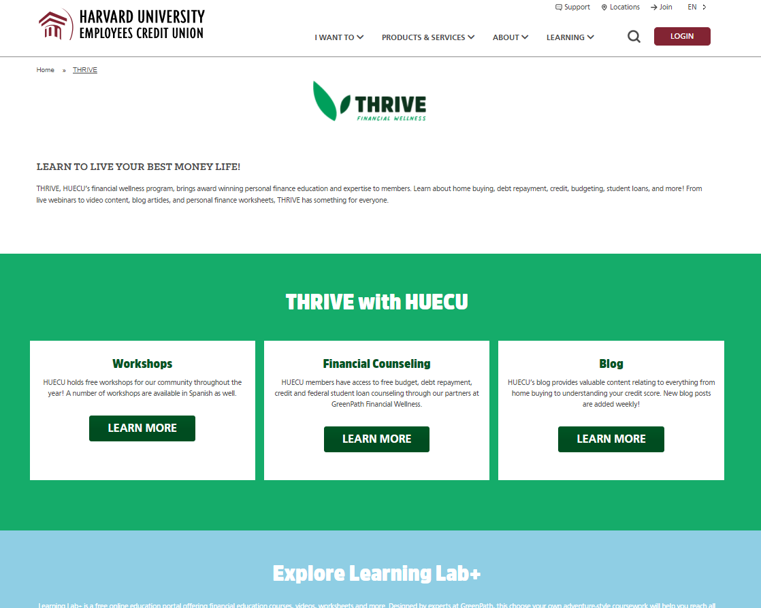
THRIVE Financial Wellness
Free Financial Counseling, Blogs, Workshops, Worksheets, Short Videos, Calculators and online education portal.
HUECU.ORG/THRIVE
Notes:
I would suggest moving this to the end of the show

Slide 8
Make a Plan

Slide 9
Lease or Buy?
Advantages of Leasing
Disadvantages of Leasing
Can drive new car every few years
Vehicle does not belong to you
May be lower monthly payment
May be hard to get out of contract
Lower up-front costs
May have to purchase a specific car insurance plan
Pay fees for:
Exceeded mileage limit
Returned condition
Terminating contract early

Slide 10
New or Used?
Advantages of Buying New
Advantages of Buying Used
Reliability
Lower cost
Manufacturer’s warranty
Slower depreciation
Customize
Disadvantages
Disadvantages
Higher cost vehicle and insurance rate
More work to learn car history
Immediate depreciation
Usually limited or no warranty
May have higher maintenance costs
May need replacement sooner
Notes:
Animate is click for each step

Slide 11
Tips for
Buying Used
Ask for repair history
Get VIN and run vehicle history report
Take to independent mechanic
Private sales offer little or no consumer protection
Most private sales are ‘as is.’

Slide 12
Keep, Sell or Trade-in?
KEEP
Will anyone in your family need a car soon?
SELL OR TRADE-IN
Research the value of your current car
Fix minor dings and scratches on car and thoroughly clean inside and out.
Can usually get more money if you sell privately than trade-in to dealership.

Slide 13
Know Your Finances

Slide 14
What is Your Budget?
CAR EXPENSES
Monthly Payment & Insurance
Taxes & Registration
Inspection
Wear and Tear
Gas & Parking
Oil Changes

Slide 15
Effects of Down Payment
PURCHASE PRICE | $25,000 | $25,000 | $25,000
DOWN PAYMENT | -$0 | -$5,000 | -$10,000
LOAN AMOUNT | $25,000 | $20,000 | $15,000
MONTHLY PAYMENT 5 years @ 5.00% | $472 | $377 | $283
TOTAL INTEREST PAID | $3,307 | $2,645 | $1,984
TOTAL VEHICLE COST | $28,307 | $27,645 | $26,984

Slide 16
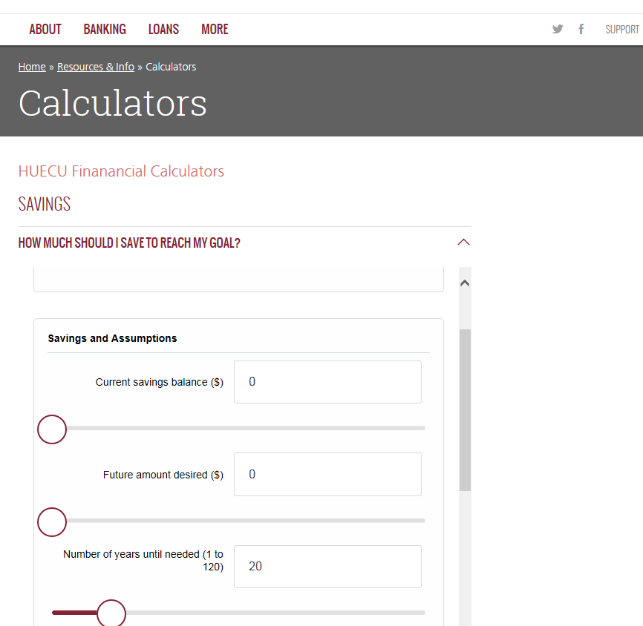
HUECU Calculators
HUECU.ORG/CALCULATORS

Slide 17
Credit Score Impact
CREDIT SCORE | 790 at 5% | 670 at 8% | 520 at 16%
LOAN AMOUNT | $20,000 | $20,000 | $20,000
MONTHLY PAYMENT 5 Year Loan | $377 | $406 | $486
TOTAL INTEREST PAID | $2,645 | $4,332 | $9,182
TOTAL VEHICLE COST | $22,645 | $24,332 | $29,182
Notes:
In the original chart there were some cells that were in red, (120 years, $552, 89 years, $575, 84 years)

Slide 18
Do You Need A Co-signer?
LENDER MAY REQUIRE CO-SIGNER IF:
Little or poor credit history
First-time buyers
Co-signer is legally responsible for debt. Car loan may have negative impact on their credit score.

Slide 19
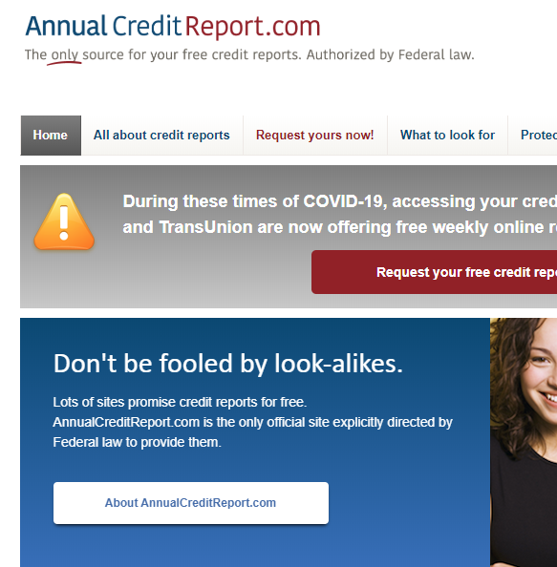
Free Credit Report
Request your credit report today.
ANNUALCREDITREPORT.COM

Slide 20
GreenPath
GreenPath Financial Wellness offers free credit, budget and COVID-19 counseling.
HUECU.ORG/GREENPATH

Slide 21
Financing Strategy

Slide 22
Cash Back or 0% Rate
CASH BACK | 0% INTEREST RATE
$25,000 | $25,000
CASH BACK | -$5,000 | -$0
REMAINING COST | $20,000 | $25,000
MONTHLY PAYMENT 5 Year Loan (5%) | $377 | $417
TOTAL INTEREST PAID | $2,645 | $0
TOTAL VEHICLE COST | $22,645 | $25,000

Slide 23
Loan Terms
TERMS | 4 YEAR
LOAN AMOUNT | $20,000
MONTHLY PAYMENT AT 5% | $461
6 YEAR
$20,000
$322
7 YEAR
$20,000
$283
ITEMS TO CONSIDER
What will be the vehicle value at the end of the term?
How will that monthly payment impact your future goals?
TOTAL INTEREST PAID | $2,108
TOTAL VEHICLE COST | $22,108
$3,191
$23,191
$3,745
$23,745

Slide 24
Shop Around For Financing
Finance Options
HUECU AUTO LOANS NEW OR USED – UP T0 110% FINANCING¹ | 6 YEAR | 7 YEAR
APR² | MAXIMUM TERM | MAXIMUM AMOUNT
AS LOW AS 7.49%³ | UP TO 72 MONTHS | $75,000 (NEW) $50,000 (USED)
Car Dealers
Banks
Credit Unions
^{1,2,3} Visit www.huecu.org for current rates and terms.
Discounts for green vehicles?
Rates differ for new versus old?
Any prepayment or refinancing penalties?

Slide 25
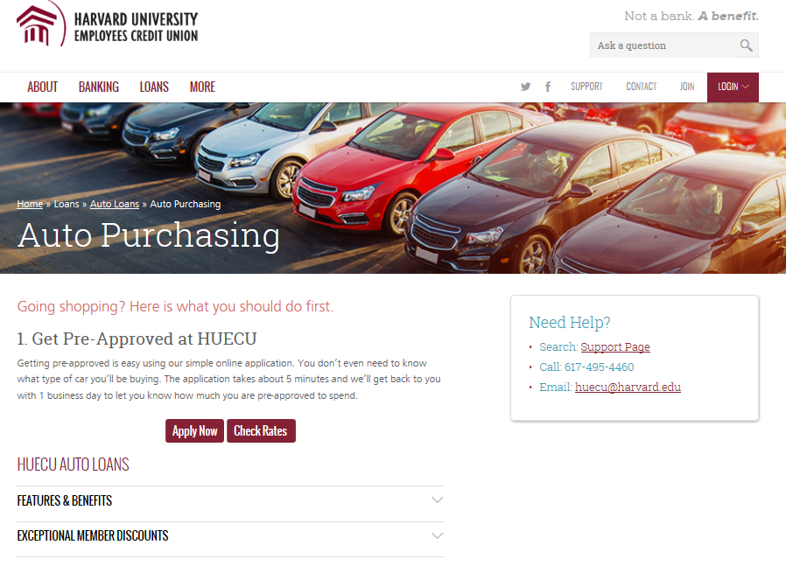
Get a Pre-Approval
Gives you an advantage when going to the car dealer.
Allows you to know rate in advance.

Slide 26
Overview of Auto Loan Process
Submit loan application (usually online)
CAR DEALER
May provide their own financing and/or work with lenders across the country
Dealership provides institution with NEW Registration and Title Application
Process usually occurs at car dealership
Sign final loan documents
Funds available for auto purchase

Slide 27
Know the Contracts
Once it’s signed you’re responsible
Ask questions
Good dealers will encourage questions, they want to protect their long term reputation

Slide 28
Know Your Rights
TRUTH IN LENDING ACT
Lender must clearly disclose terms of borrowing
CONSUMER LEASING ACT
Lessor must clearly disclose terms of leasing
LEMON LAW
Entitled to new car or refund if buy lemon
Usually only applies to new cars

Slide 29
We Blog
Subscribe or visit our website.
BLOG.HUECU.ORG
Notes:
I would suggest moving this to the end of the show

Slide 31
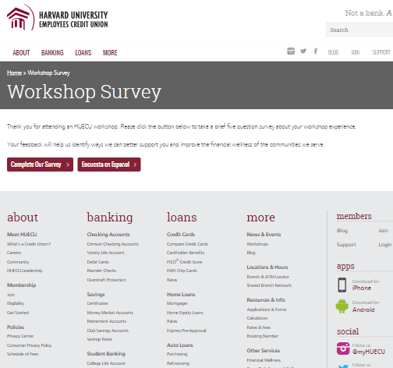
Survey Says!?
Let us know how you liked this webinar
HUECU.ORG/SURVEY
Notes:
I would suggest moving this to the end of the show

Slide 32
Disclaimer
This presentation is a general overview of principles you may want to consider. Only you can decide what is best for you. This presentation is educational in nature and is not intended to be, and should not be construed as tax, legal or investment advice. You should always consult a certified advisor for advice on your specific situation. The examples used in this presentation are for illustrative purposes only.
Notes:
Does this work for the below slide?

Slide 33
Keep in Touch
huecu@harvard.edu
huecu.org
@myHUECU
Find us on all social channels
104 Mount Auburn Street
Cambridge, MA 02138

